Slide 1
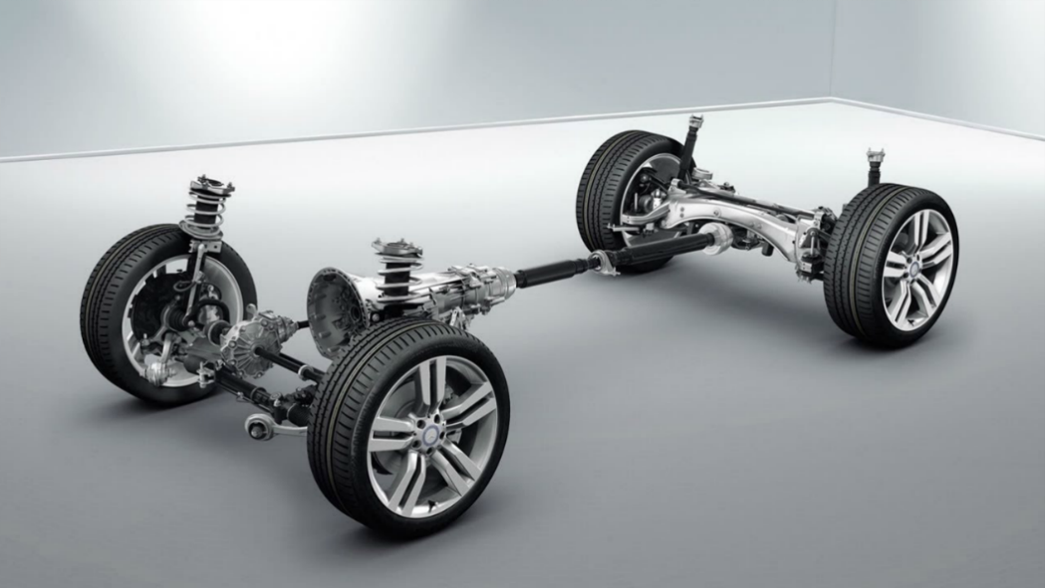
Project work – Status Report Suspension Modelling
Source: https://www.betsautos.co.uk
Saraschandran Kottakalam 762238
Amit Pandit 762243
Stevano Nifuata Zagoto 762182

Slide 2
Structure
Vehicle specifications
Input data
Model on Matlab Simscape
Model on Lotus
Chamber angle comparison (Lotus and Simscape)
Further actions

Slide 3
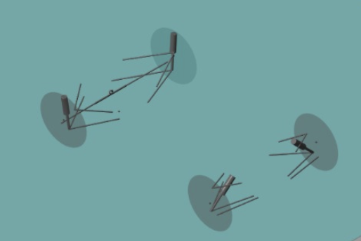
Vehicle Specifications
Vehicle geometry - assumed (total weight, moment of inertia, etc.)
Kinematic points - obtained from Rennstall
Suspension system - Double A-Arm suspensions in the front and rear

Slide 4
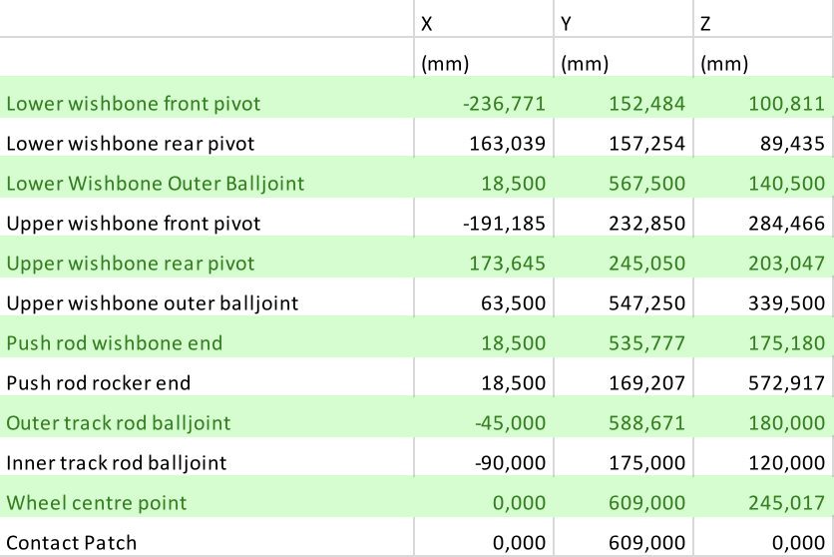
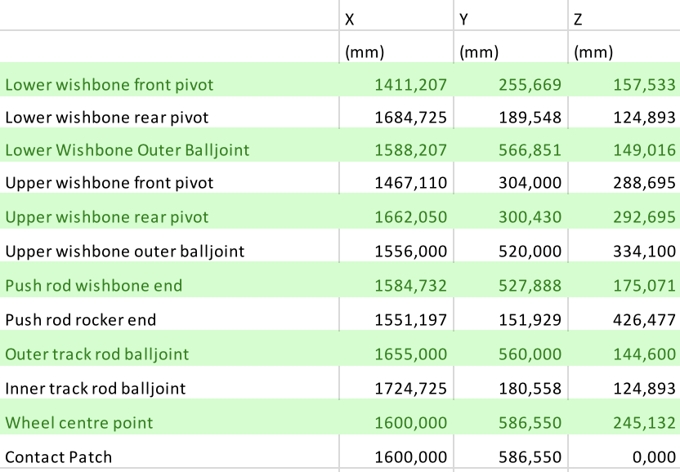
Input Data
Kinematic points → provided by Rennstall

Slide 5
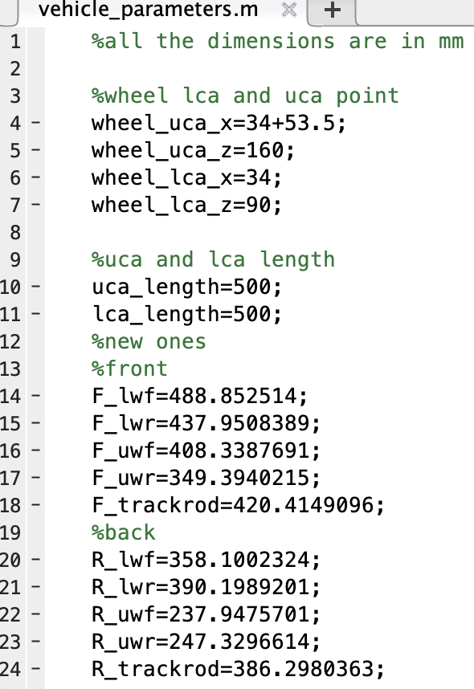
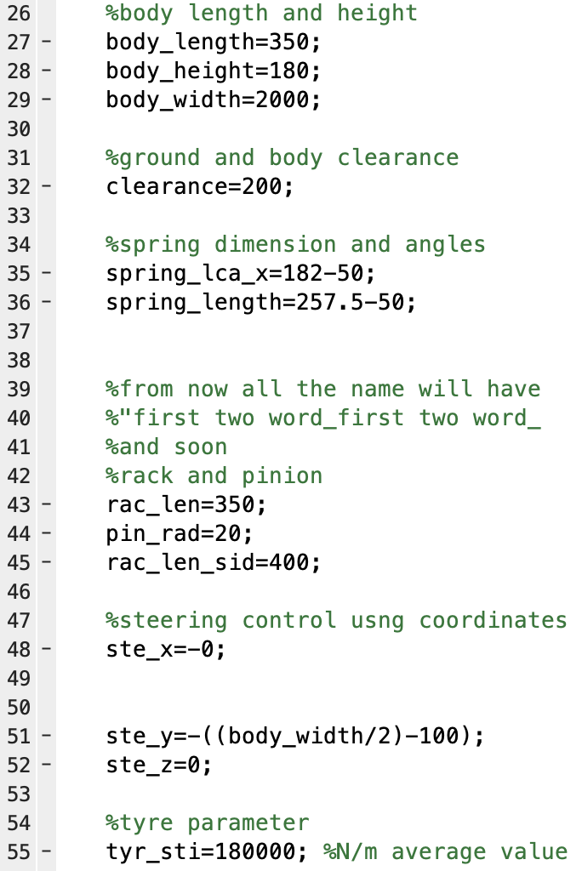
Matlab - Vehicle Parameter

Slide 6
Matlab Simulink Blocks
Steering
Front left wheel
Rear left wheel
Front right wheel
Rear left wheel

Slide 7
Front right wheel

Slide 8
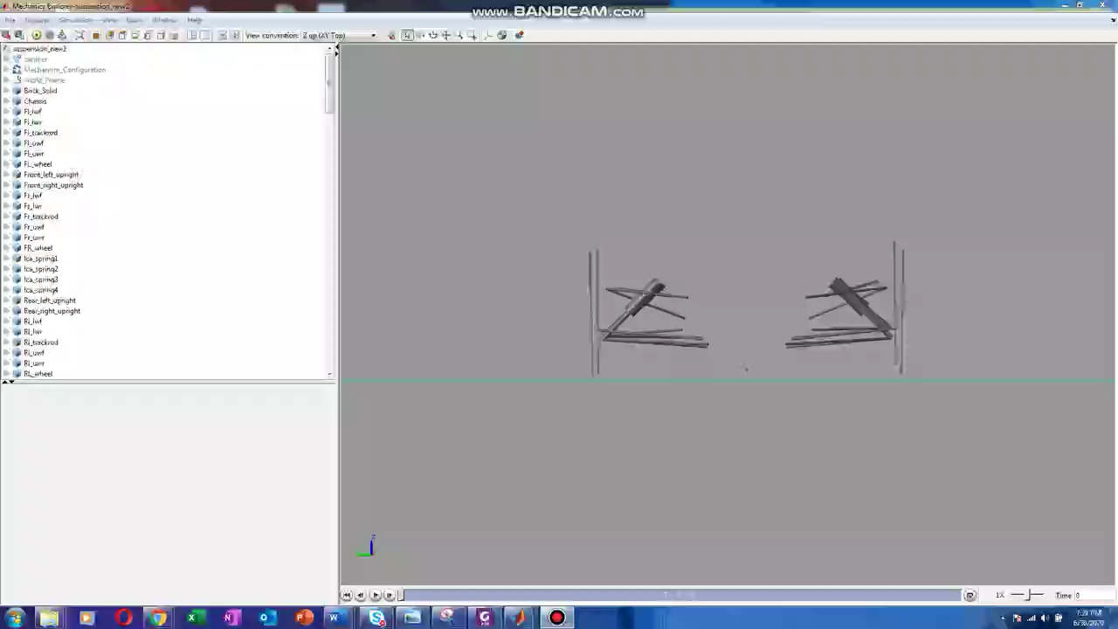
Matlab Simulink Result
The body is fixed and the ground is moved upwards to analyse bump and droop

Slide 9
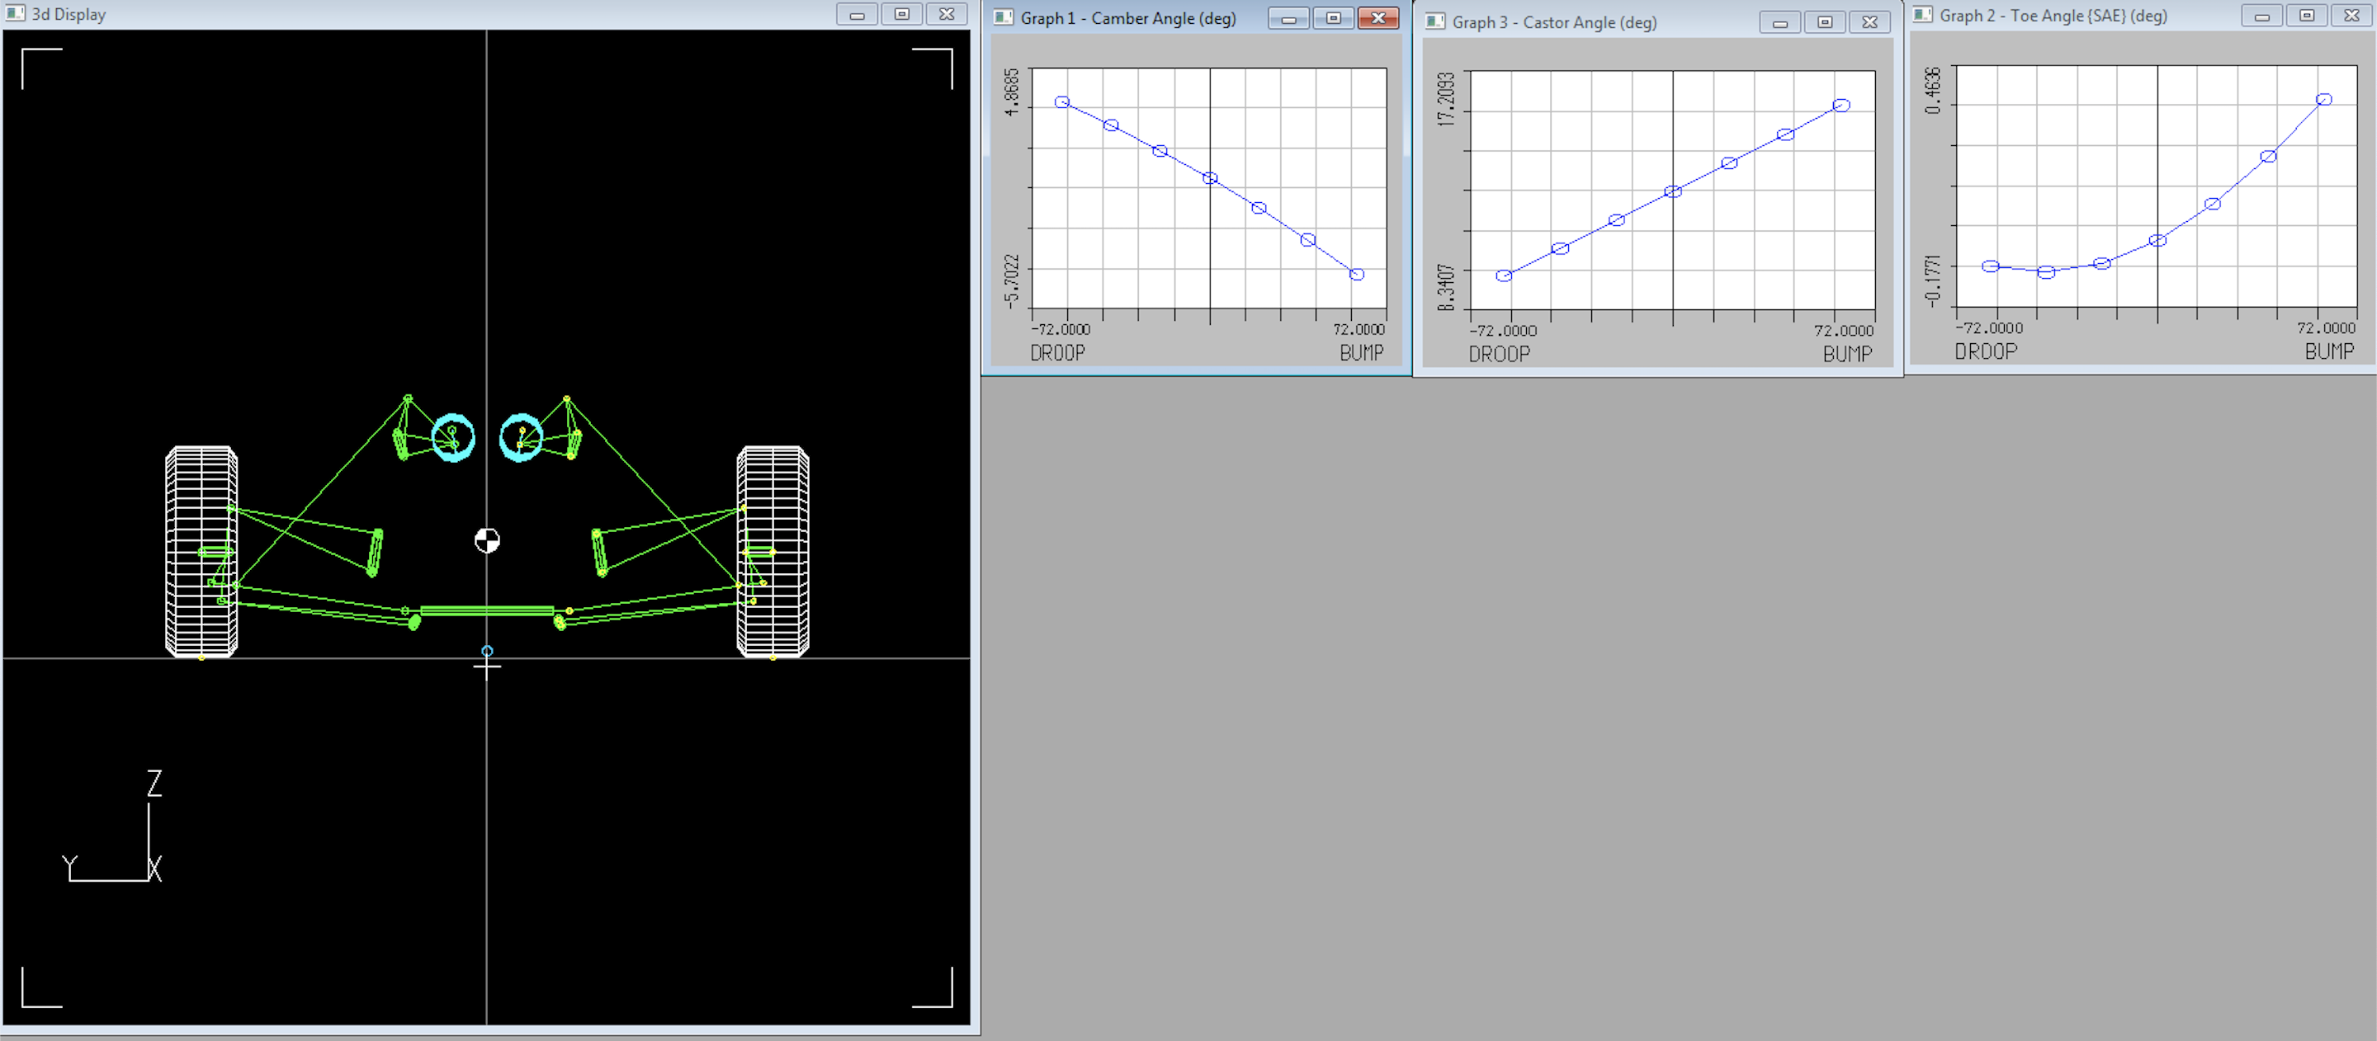
Lotus result

Slide 10
Matlab code and graph

Slide 11
Chamber angle comparison (Lotus vs Matlab)

Slide 12
Further Actions
Comparison of experimental result with matlab data
Prepare the tyre contact patch (magic formula)
Provide torque to the rear wheel in the straight path

Slide 13
Thank you for your attention!

